Slide 1
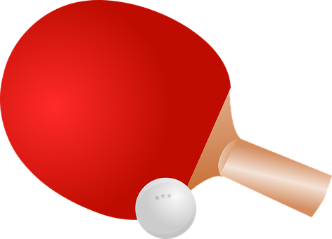
Gnop
Tylor DeRemer, Elijah Gonzalez, Christian Deasis

Slide 2
Overview
Gnop is a variation of the classic Pong game
Pay homage to the game that jump started the industry.
Video game developers can use this as a loading/transitional screen.

Slide 3
Gnop Functionality
Design
The ball races across the screen increasing in speed as the user tries to survive the 60 seconds.
Once the ball collides with the bottom border, the time resets and the ball slows to original speed.
Score and Display
The time remaining and name of the game is shown on the 7 segment display.

Slide 4
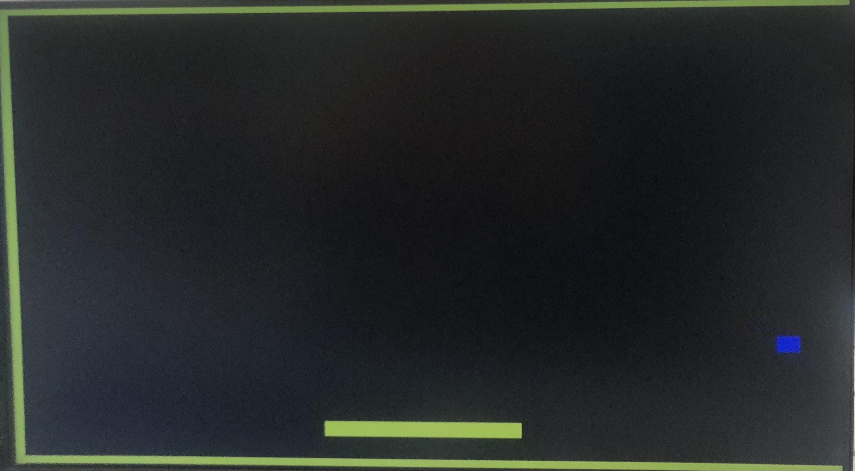
Game Preview
Left and right buttons on the FPGA are used to slide the paddle across the screen. As the time counts down the ball’s speed increases racing you to the final seconds.
Place your screenshot here
GNOP

Slide 5
Specification and Constraints
Collision Detection
Collision Detection work by using the modified parameters of border and paddle with current ball X and ball Y position.
Time Display
The name of the game is survival. The longer you live the harder and faster the ball begins to move until down to the last second.
Difficulty/Speed Reqs
Even though the starting position of the ball is the same, the game is never the same. With 8 difficulties and ball movements increasing with speed.

Slide 6
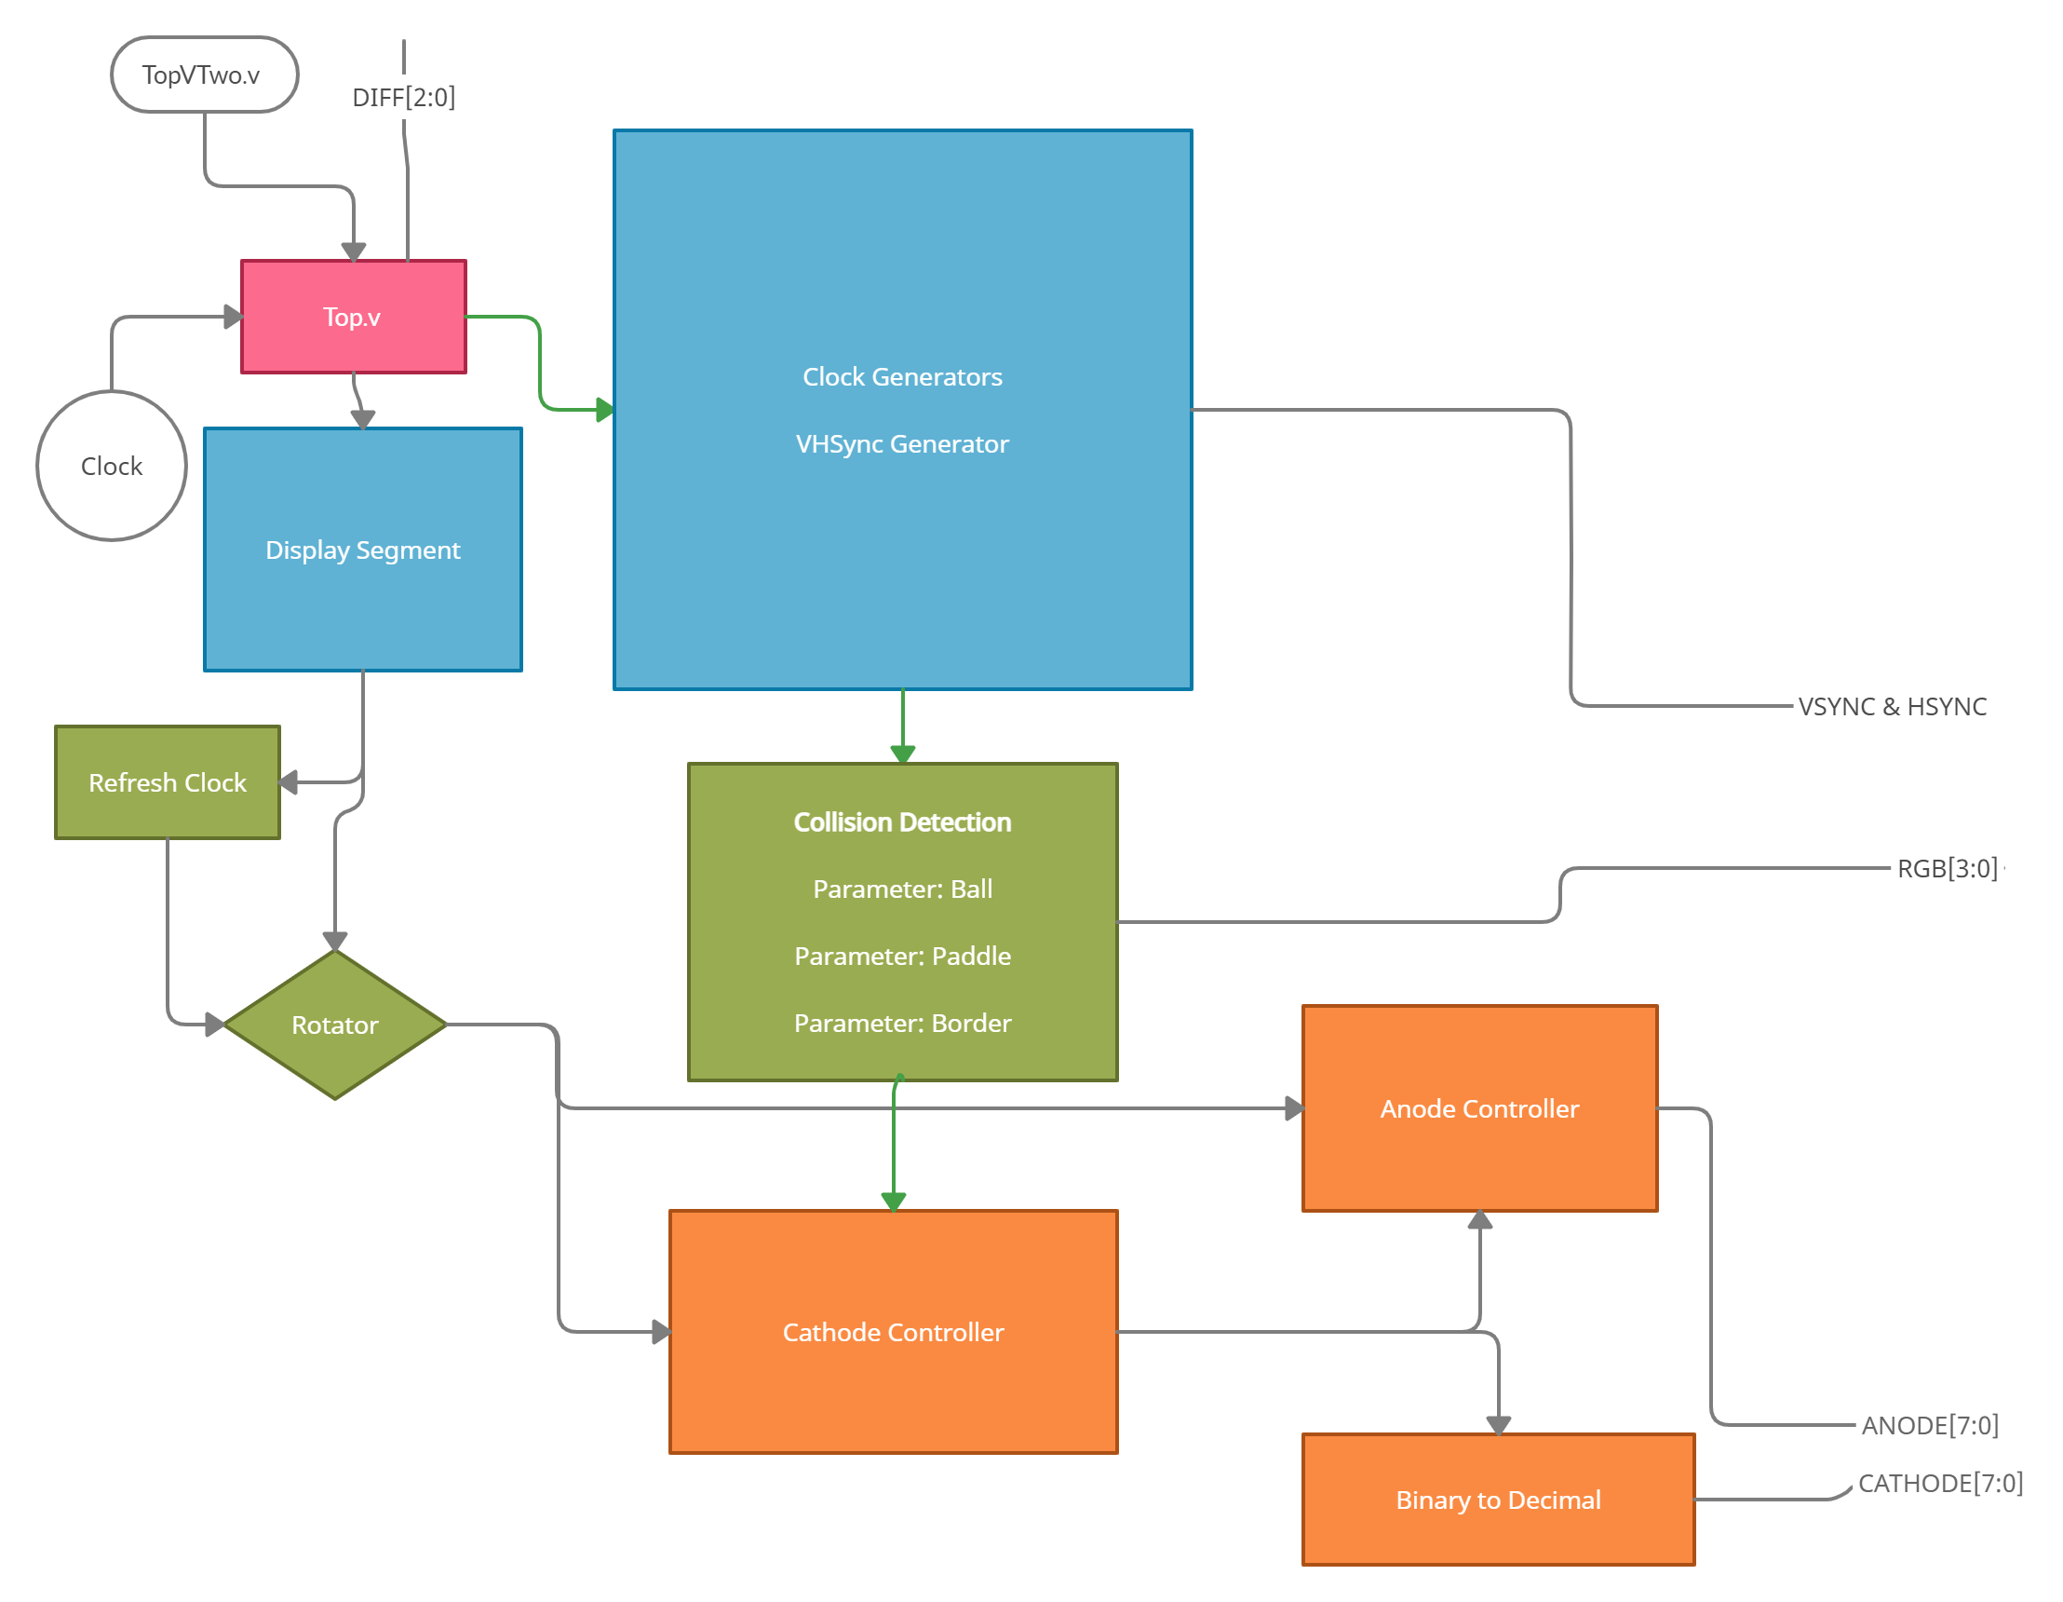
Block Diagrams

Slide 7
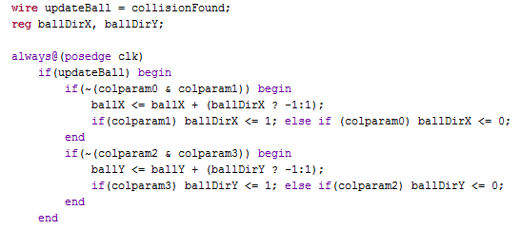
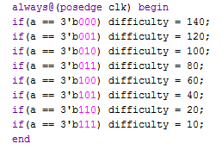
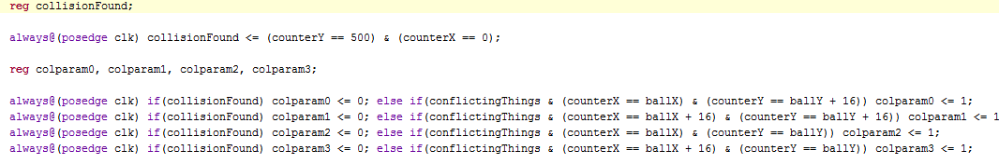
Code Snippet

Slide 8
Successes
Collision Detection
The collision detection system is derived from an example online. The modifications were made to it to follow a modified clk speed as the game changed. This implementation proved difficult as the refresh rate of the screen had to maintain the same, where as the RBG refresh rate needed to match the balls change in clk speed.
Customizable Paddle Sizes
Difficulty of the game changes depending on the size of the paddle. You can have a paddle 12 times the size of the ball, or 2/3rds the size of the ball.
Idea Strides Away From Traditional Pong
I consider the idea of the project to be a success since when I was implementing the design and the game I had needed to make a variation so my game would be different.

Slide 9
Failures
Right Border Not Displayed
During setup I had used a tutorial video on VSync and HSync Generator for the creation of the VGA sync. It seemed to create a bug in which the screen dimensions were 720x480. This was never resolved.
Ball Movement Speed Modification
I didn’t get to implement the difficulty setting for the ball movement speed as well as the paddle size changes.
Modular Implementation
I had struggled a large portion of designing the project with the idea of using a more modular approach. This had seemed to work initially and now that I reflect it is possible. However, I had not been using the proper clk speed which in-turn made it not work.

Slide 10
THANKS!

